Slide 1


Amazon Review Classification Using NLP
By Abhishek Mohapatra

Slide 2

Content
India needs a boost to its economy that can also simultaneously transform local businesses.
In order to support Indian brands, 'Vocal for Local' campaign was started in India.
Emphasizing on a self-reliant, or ‘Aatmanirbhar’, India, the Indian government has asked that products not just be made in India, but also for the promotion of local brands, manufacturing, and supply chain.

Slide 3

Amazon Review
This dataset comprises of 2500+ reviews of about 100+ Indian Products pertaining to categories like hair and skin care products, clothes, electronic gadgets, etc. from Amazon.

Slide 4
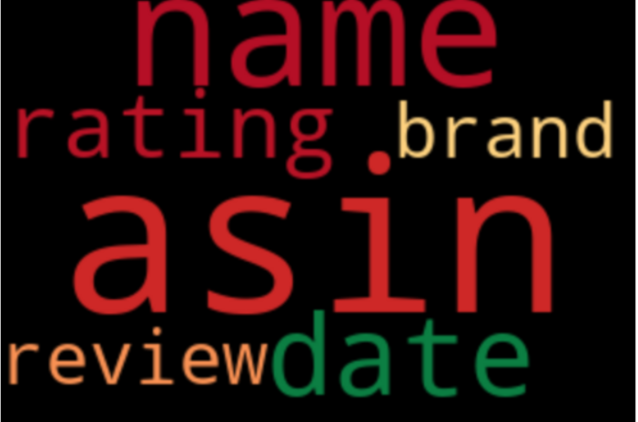
Column Description
Asin : Amazon Standard Identification Number –
A unique id for each product on Amazon
Name : name of the product
Date : date on which review was posted
Rating : rating given to the product ( out of 5 )
Review : review given to the product

Slide 5
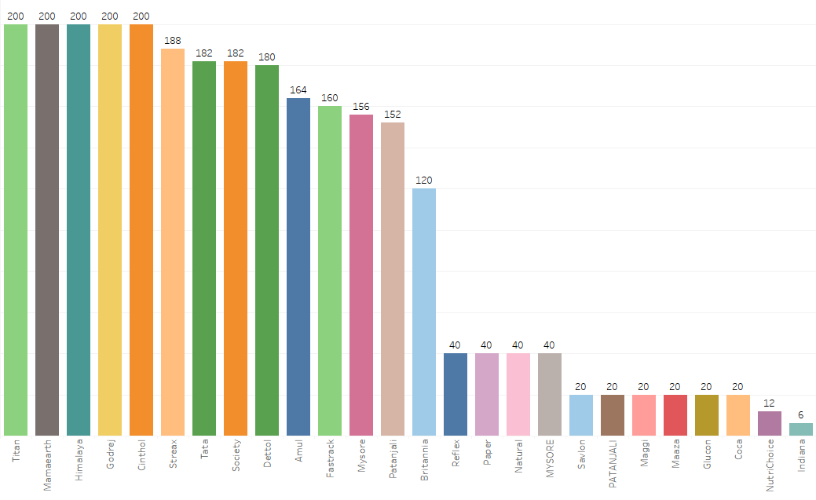
Products Purchased
The given graph represents the Count of products Purchased from each Brands.

Slide 6
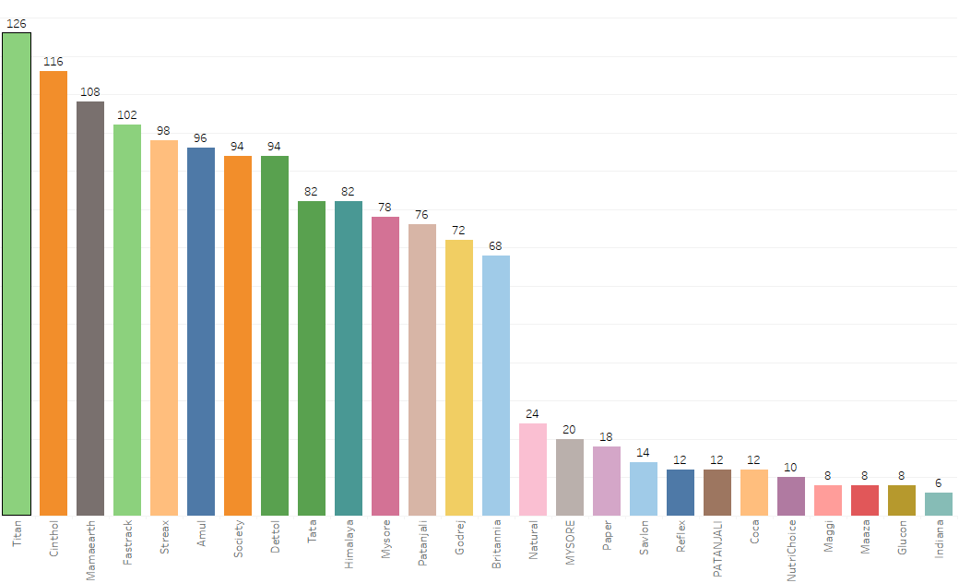
5-star Rated Brand Purchased
From the Graph we can say that “Titan” brand Product and many more has been Rated as 5 stars the most and is liked by many Customers.
And People are more Relying Mostly on “Titan” and Other products too. So, Seeing this in the Future People might be going for these products more than anything as per their requirements.

Slide 7
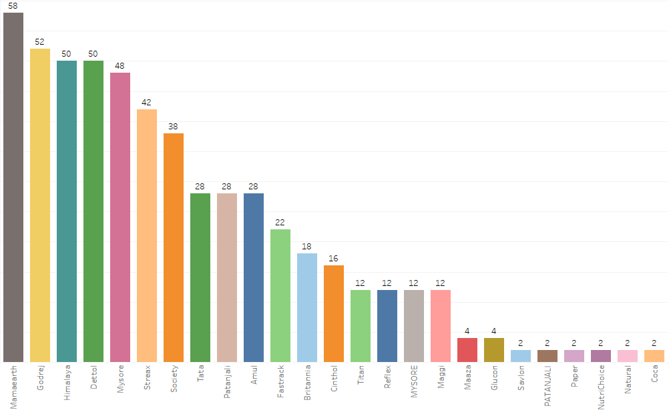
1-star Rated Brand Purchased
Here we can say that “Mama-earth” brand Products and many other brands has been Rated as 1 stars and is disliked by many Customers the most.
The Reason can be anything : what if the product was good but delivery was not within time or what if the product was a damaged one which can happen with anyone in one in 100s but can’t blame the brand. So, there can be Multiple Reason for Rating 1 star.
So, Seeing this in Future People might not go for these products and they might choose a different brand. Hence, these brands must focus on their Customers.

Slide 8

Selecting the Required Features for Model Building
So, Moving forward we just require those columns which can be used for Model building using NLP.
We will be considering Only the ‘Review’ column as our Independent Feature and ‘Rating’ as Dependent feature(Target Variable).
Our goal is to check whether the Review and Ratings are Directly Proportional to each other i.e., if we are building models by using some of the basic Algorithms and predicting that if there is a Rating given ,is the Review as Similar as it is to the Rating or not.
The product was good ,I will recommend my friends too
The delivery was not in Time

Slide 9
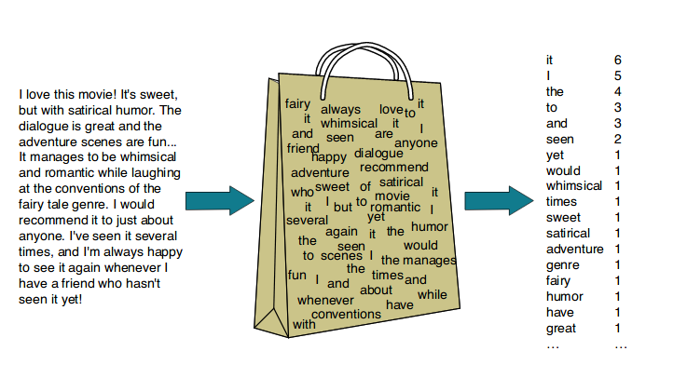

Word Embedding using NLP
Now we have to Clean and convert the Data in ‘Reviews’ from Word Embedding using NLP. Some of the Processes involved in converting Word Embedding are:
1
Tokenization.
2
Stop words removal.
3
Lowering the case.
4
Lemmatization/Stemming
5
Word to vector (BOW/TF-IDF)

Slide 10
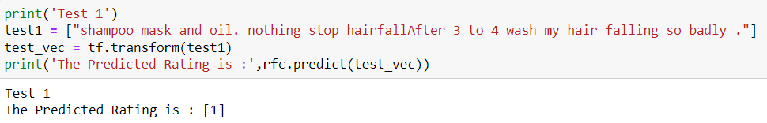
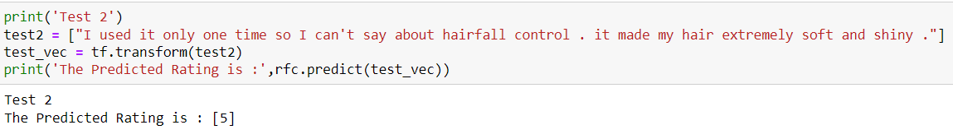
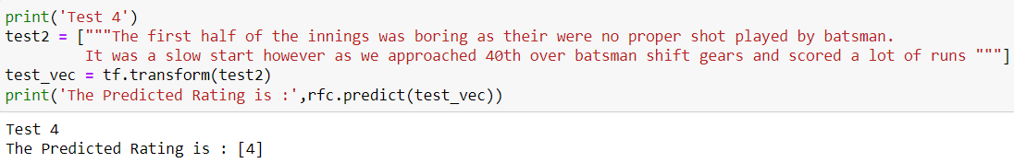
Final Test
As we have modelled our data we will now be testing it on random review to check how accurate is the rating. Try it:
1
2
3

Slide 11

Final Conclusion
So, by using the algorithm as Random Forest Classifier and Technique as TF-IDF since it provides for Semantic Meaning to the data and Hence, we got a good model having a Good Precision, Recall and Accuracy of 98% Hence, we can Conclude that the 'Review' and the 'Rating' are Accurate as per the ratings Provided by the Customers on the Indian Products.
And In future if there is any new data updated will be automatically classified into the Major ratings as per the Model.
Since the model is able to classify the Reviews accurately it will be useful for the Organization /Companies to improve areas where they are lacking.

